Slide 1

CIS 2348 Final Project
The ELECTRONICS INVENTORY PROGRAM (EIP)
Designed, built, and tested by:
Joshua Fitzgerald
1374331

Slide 2

Getting Started
Analyzed project requirements
Determined the need for a database structure
Researched various database creation methods/modules using Python
Tested multiple methods/modules with project data
Finalized decision to use SQLite3 and Pandas modules

Slide 3
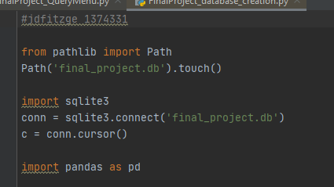
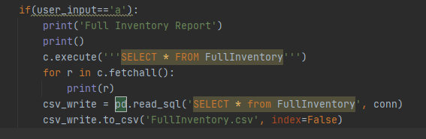
SQLite3 and Pandas
Used pathlib to create database
Used sqlite3 to connect to database and run queries
Used pandas to create table and read/write queries, to and from CSV files

Slide 4
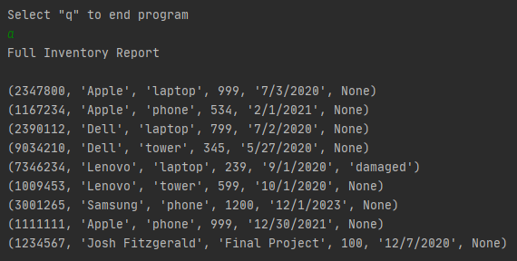
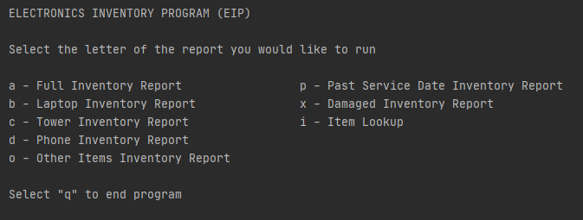
End Results
Created Inventory database from provided CSV files using Python
Built and tested queries that return information about inventory data
Built and tested interactive Python program that uses SQLite3 queries to allow users to run reports, export reports to CSV’s and run item searches from the database.

